Slide 1
Create A Project Using Block Chain To Detect The Fake Products
SlideMake.com

Slide 2
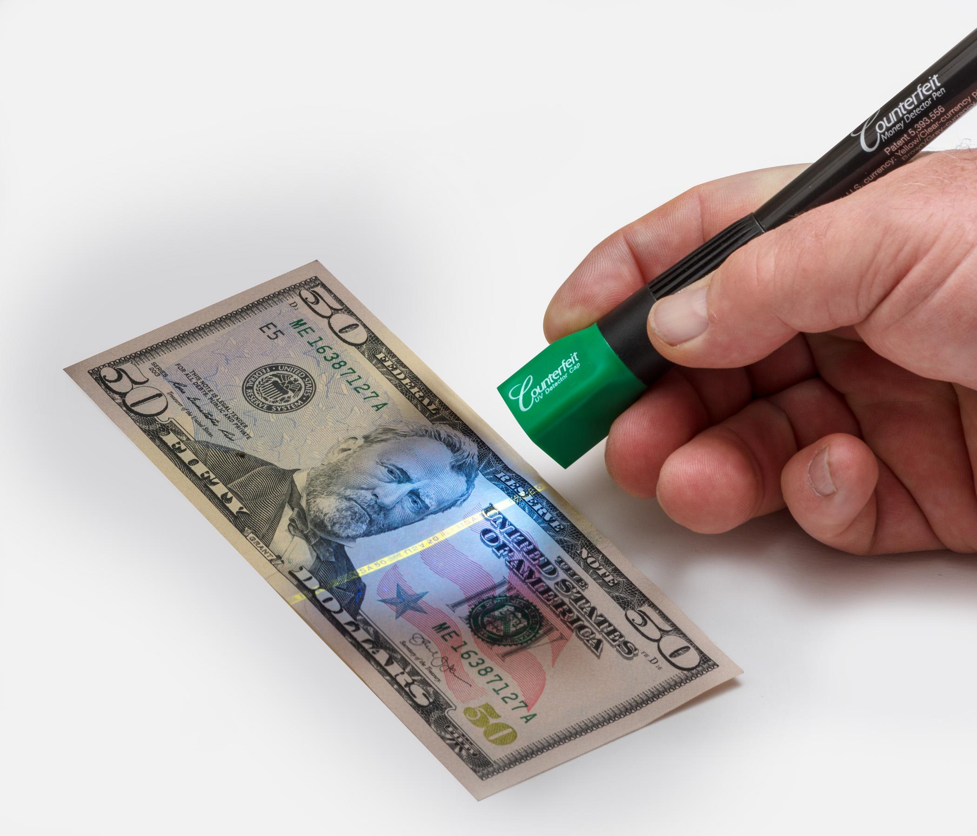
Introduction to Blockchain-based Project for Detecting Fake Products
The rise in counterfeit products poses a significant challenge for consumers and businesses alike.
Blockchain technology offers a potential solution to combat the proliferation of fake products.
This presentation discusses the concept and benefits of using blockchain to detect and prevent counterfeit goods.
1
Notes:
Image source: https://www.amazon.ca/Drimark-Dual-Counterfeit-Detector-351UVB/dp/B0053Y5Q8Y

Slide 3
Understanding Blockchain Technology
Blockchain is a decentralized, transparent, and immutable digital ledger that records transactions.
It ensures data integrity, security, and trust through cryptographic algorithms.
Blockchain's decentralized nature eliminates the need for intermediaries, making it ideal for supply chain management.
2
Notes:
Image source: https://www.gisreportsonline.com/r/blockchain-decentralized-ledger-transactions/

Slide 4
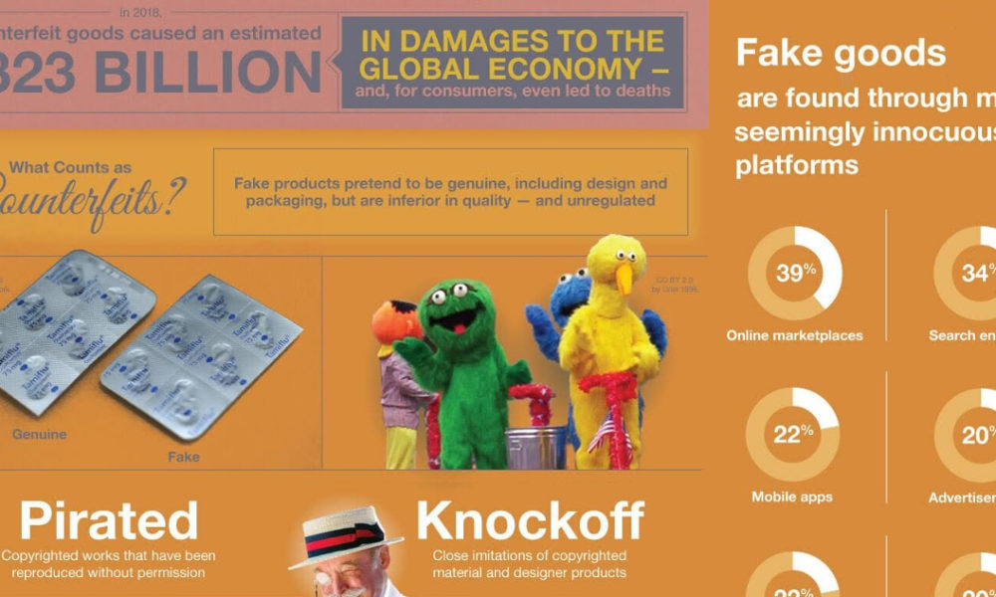
The Problem of Fake Products
Counterfeit products can cause harm to consumers, damage brand reputation, and lead to substantial financial losses.
Traditional methods of detecting counterfeit goods are often inefficient, time-consuming, and prone to human error.
A blockchain-based solution can provide a secure and efficient way to track and authenticate products throughout the supply chain.
3
Notes:
Image source: https://www.visualcapitalist.com/300-billion-counterfeit-goods-problem/

Slide 5
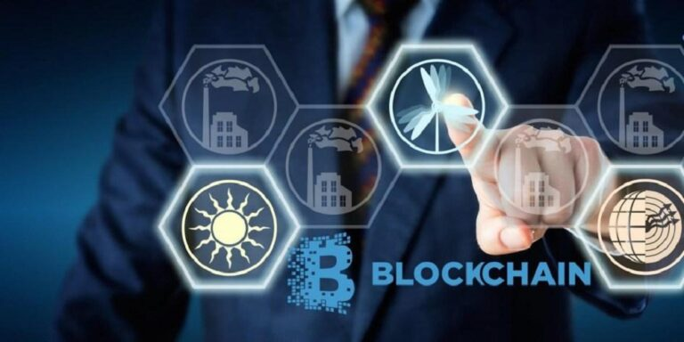
How Blockchain Can Detect Fake Products
Each genuine product can be assigned a unique identifier or digital token on the blockchain.
The blockchain records the entire lifecycle of the product, including its origin, manufacturing, distribution, and sale.
Consumers can verify the authenticity of a product by scanning its QR code or accessing the blockchain record.
4
Notes:
Image source: https://www.financeupdates.net/how-to-detect-fake-product-through-blockchain-technology/

Slide 6
Benefits of Blockchain-based Product Detection
Increased transparency: Blockchain provides a transparent and auditable record of each product's journey.
Improved traceability: Tracking products on the blockchain enables easy identification of counterfeit items.
Enhanced consumer trust: Blockchain's immutability assures consumers of product authenticity, fostering trust in brands.
5
Notes:
Image source: https://www.gisreportsonline.com/r/blockchain-decentralized-ledger-transactions/

Slide 7
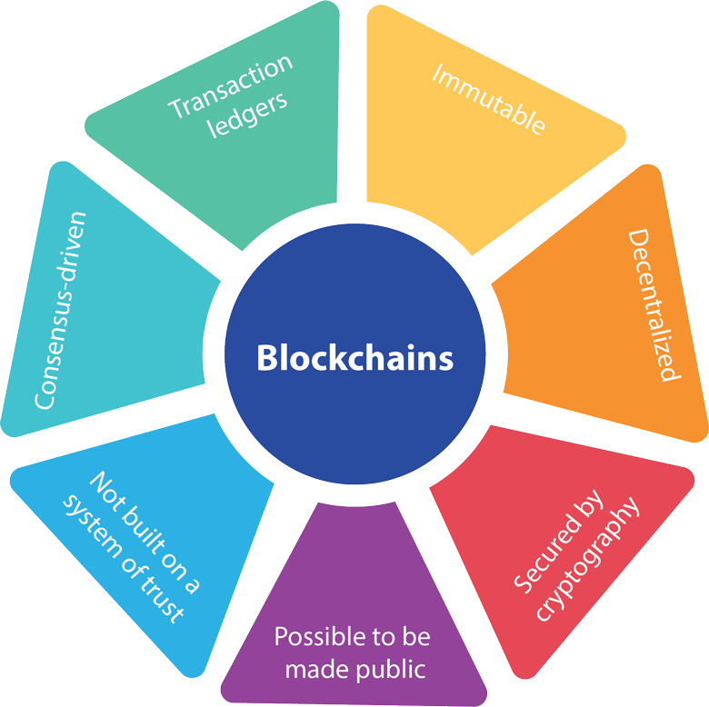
Implementation Challenges
Integration with existing systems: Adopting blockchain technology may require integration with legacy systems and industry-wide collaboration.
Data privacy and security: Ensuring secure and private sharing of product-related information can be a challenge.
Scalability: Blockchain networks must handle a large volume of transactions in real-time to accommodate global supply chains.
6
Notes:
Image source: https://www.softwebsolutions.com/resources/implementing-blockchain-in-business.html

Slide 8

Real-world Examples
VeChain: A blockchain platform that verifies and tracks luxury goods, wines, and automotive parts.
IBM Food Trust: A blockchain-based solution that ensures food safety and traceability.
Provenance: A platform using blockchain to verify the authenticity of products, such as diamonds and clothing.
7
Notes:
Image source: https://www.cryptonewsz.com/a-detailed-review-of-blockchain-firm-vechain-its-core-functionalities/

Slide 9
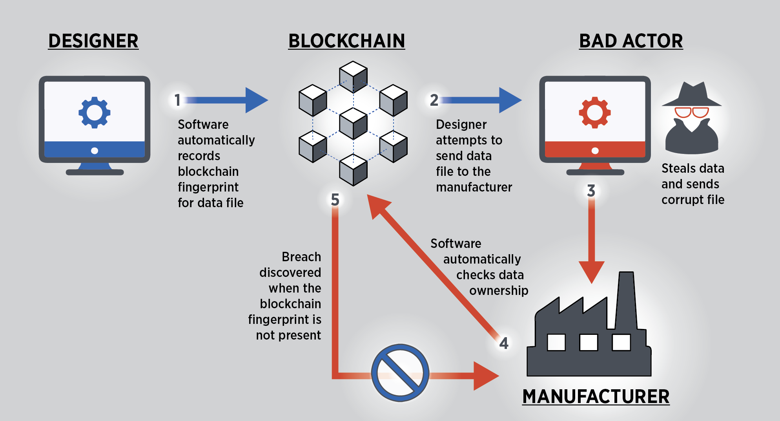
Potential Impact and Future Developments
Blockchain-based product detection can significantly reduce the circulation of fake goods, benefiting both businesses and consumers.
Collaboration between stakeholders, including manufacturers, retailers, and consumers, is crucial for widespread adoption.
Continued advancements in blockchain technology, such as scalability improvements and privacy enhancements, will further enhance its effectiveness.
8
Notes:
Image source: https://www.nist.gov/image/blockchainmanufacturingfinalpng

Slide 10
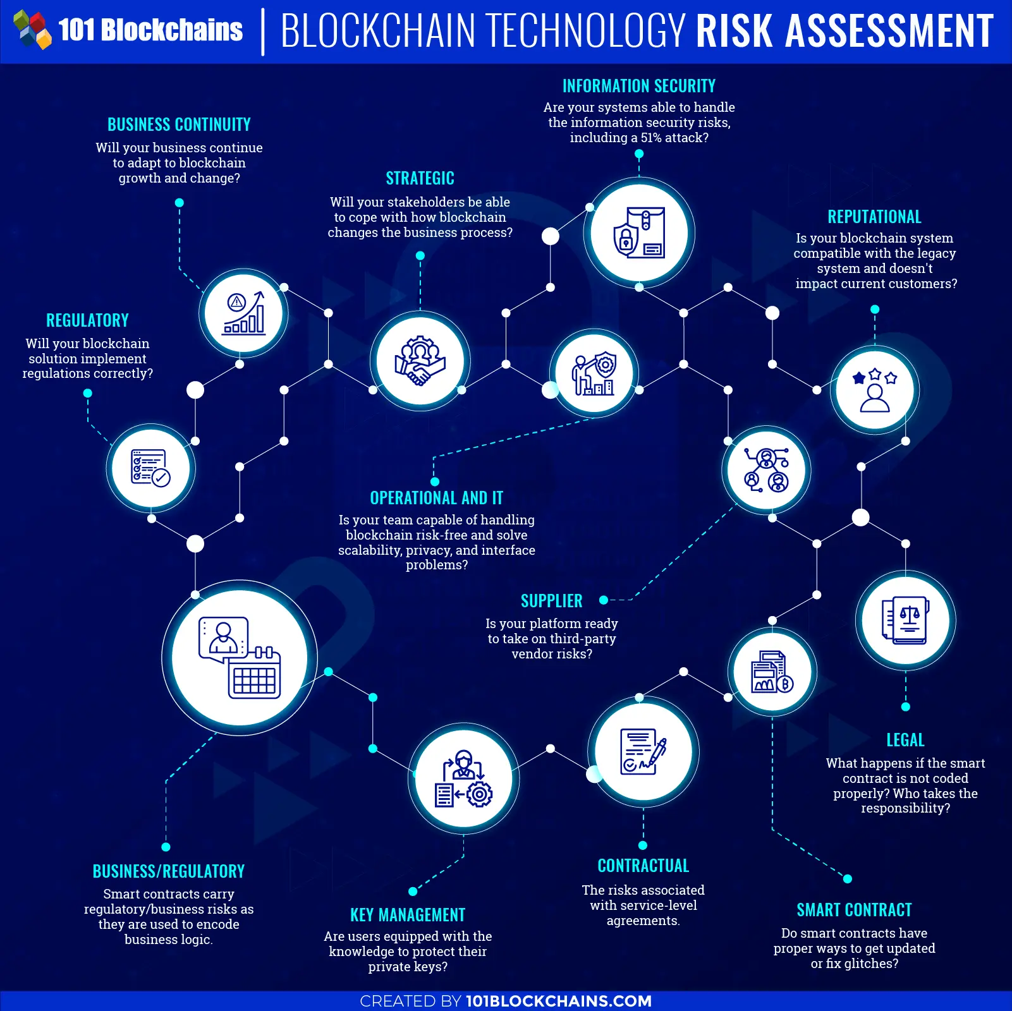
Conclusion
The rise of counterfeit products necessitates innovative solutions.
Blockchain technology offers a promising approach to detect and prevent fake products.
By leveraging blockchain's transparency, traceability, and immutability, we can protect consumers and safeguard brand reputation.
9
Notes:
Image source: https://101blockchains.com/enterprise-blockchain-risk-assesment/

Slide 11
References
VeChain. [Online]. Available: https://www.vechain.com/
IBM Food Trust. [Online]. Available: https://www.ibm.com/food/
Provenance. [Online]. Available: https://www.provenance.org/
10

